Slide 1
Value engineering and Analysis
Module V
By
Dr Hemalatha K

Slide 2
Definitions & Importance
Value Engineering
  It is concerned about new products
  It is crucial activity during product development stage
  Its intention is reducing costs and improving function
  Many factors influence : tooling, plant and equipment, labour and skills ,training costs, materials, shipping, installation, maintenance and recycle costs.
  Definition:
    value engineering is a systematic approach aimed at achieving the desired functions of a product at minimum overall cost, without affecting the quality, reliability, performance and safety.
    It is neither high valued suggestion program nor a means of cheapening an item, process, or procedure. It does, however, seek to eliminate unnecessary costs.

Slide 3
Principles of VE
Value Engineering determines the basic function of an item.
Value Engineering evaluating high cost areas and systematically reducing those costs.
Value Engineering analyzes a problem area and developing
alternative ways of resolving the problem.
Value Engineering selects the best possible alternative to perform the basic function at the lowest cost.
Value Engineering presents and promotes a proposal.
Value Engineering also simplifies, resulting in increased reliability and ease of maintenance.
Value Engineering extends financial, manpower, and material resources.

Slide 4
Value Analysis
Value Analysis (VA) is concerned
with existing products. It involves a current product being analyzed and evaluated by a team, to reduce costs, improve product function or both.
Value Analysis exercises use a plan which step-by-step, methodically evaluates the product in a range of areas.
– These include costs, function, alternative components and
design aspects such as ease of manufacture and assembly.
A significant part of VA is a technique called Functional Analysis, where the product is broken down and reviewed as a number of assemblies or small tasks. Each assembly will be analyzed with its assigned cost.
As with VE, VA is a group activity that involves brainstorming improvements and alternatives to improve the value of the product, particular to the customer.

Slide 5
Phases or Steps in Value Engineering
Creative: The Creative (also referred to as Speculation) Phase follows Investigation and is where the power and the benefits of the VE study technique are manifested (tools or analysis ideas). The team applies brainstorming techniques to develop viable alternatives to the way the project is currently designed. Brainstorming forces people to be creative.
The team uses the generic format of the function to speculate on all possible solutions to the problem presented in that functional statement.
The value study team applies creativity to the functional statements selected from the previously conducted cost/worth estimates.
  Based on the project experiences
This VE study generate a large list of potential solutions to the problem described by the two-word function
  Write problem of analysis
  Defines the objectives

Slide 6
Evaluation: During the Evaluation Phase, the advantages and disadvantages of each alternative are listed. Each advantage and disadvantage is described in general terms.
The team can perform a weighted matrix analysis to determine which alternative is best based upon the relative importance of each of the desirable criteria which must be addressed.
Conducting this analysis satisfies the VE objective--to achieve the best blend of performance, cost, and schedule.

Slide 7
Development: Once the team selects the best alternatives, that are developed through sketches, cost estimates, validation of test data, and other technical work to determine if any assumptions made during the study are in fact considered.
The Development Phase is the final step before presenting the team's recommendations to the agency's management.
The study team formulates an implementation plan which describes the process that the agency must follow to implement any recommendations.
  Architecture
  Tools
  methodology

Slide 8
Presentation: The final product of a VE study is the formal VE Report and the presentation of the team's recommendations.
In this phase, the VE team presents their findings to the project decision makers, and strives to convince them that their ideas should be implemented.
This formal presentation should be brief but thorough, with sufficient time allocated for discussion and responding to questions. When making the presentation, the study team should exercise care when presenting estimated cost savings or, in some cases, increased costs associated with recommendations. Overstating or double counting savings should be avoided.
The study team to provide progress updates to the appropriate project management staff as a VE report.
  The VE Report serves as a step-by-step record of the work accomplished during the preceding phases.
  The report provides documentation to support the team's recommendations, tracks the team's deliberations and considerations, and aids in implementation of the recommendations. It can also be a useful reference tool for future projects and VE studies that must address similar topics.

Slide 9
Close Out/Implementation: Although it may not be practicable to implement each and every recommendation proposed, the project decision makers must take the appropriate action to ensure that a fair and serious consideration of the proposed recommendations occurs.
It involves determining the actual amount of savings generated by the VE analysis based on the amount of recommendations and outcome of the project.

Slide 10
SDLC Models

Slide 11
SDLC Models
Waterfall Model
V-Shaped Model
Evolutionary Prototyping Model
Spiral Method
Iterative and Incremental Method
Agile development

Slide 12
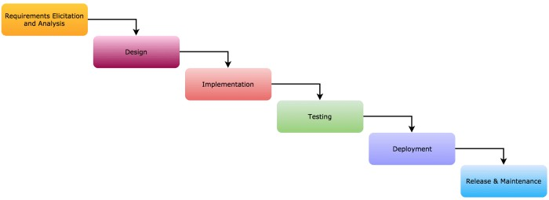
Waterfall Model
The Waterfall Model is a linear sequential life cycle flow.
It was first SDLC Model to be used widely in Software Engineering to ensure success of the project
Progress is seen as flowing steadily downwards
through the phases of software implementation.
Any phase in the development process begins only if the previous phase is complete.
No overlapping among the phases.

Slide 13
The usage
Projects which not focus on changing the requirements, the customer has a very clear documented requirements
Some situations where the use of Waterfall model is most appropriate are
  Requirements are very well documented, clear and fixed.
  Product definition is stable.
  Technology is understood and is not dynamic.
  There are no ambiguous requirements.
  Ample resources with required expertise are available to support the product.
  The project is short.

Slide 14
Phases in Waterfall model
Requirement Gathering and analysis
  requirements of the system to be developed are captured in this phase and documented in a requirement specification document
System Design
  The requirement specifications from first phase are studied in this phase and the system design is prepared
  It helps in specifying hardware and system requirements and helps in defining the overall system architecture.
Implementation
  With inputs from the system design, the system is first developed in small programs called units, which are integrated in the next phase. Each unit is developed and tested for its functionality, which is referred to as Unit Testing.
Integration and Testing
  All the units developed in the implementation phase are integrated into a system after testing of each unit. Post integration the entire system is tested for any faults and failures
Deployment of system
  Once the functional and non-functional testing is done; the product is deployed in the customer
environment or released into the market.
Maintenance
  There are some issues which come up in the client environment. To fix those issues, patches are released. Also to enhance the product some better versions are released. Maintenance is done to deliver these changes in the customer environment.

Slide 15
Advantages | Disadvantages
Simple and easy to understand and use Easy to manage due to the rigidity of the model. Each phase has specific deliverables and a review process. Phases are processed and completed one at a time. Works well for smaller projects where requirements are very well understood. Clearly defined stages. Well understood milestones. Easy to arrange tasks. Process and results are well documented. | No working software is produced until late during the life cycle. High amounts of risk and uncertainty. Not a good model for complex and object-oriented projects. Poor model for long and ongoing projects. Not suitable for the projects where requirements are at a moderate to high risk of changing. So, risk and uncertainty is high with this process model. It is difficult to measure progress within stages. Cannot accommodate changing requirements. Adjusting scope during the life cycle can end a project.

Slide 16
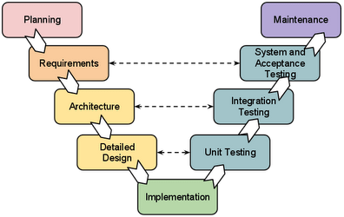
V-Shaped Model
It is an extension of the
waterfall model,
It is also known as verification and Validation model.
Instead of moving down in
a linear way,
the process steps are bent upwards after the implementation and coding phase, to form the typical V shape.
The major difference between the V-shaped model and waterfall model is the early test planning in the V-shaped model.

Slide 17
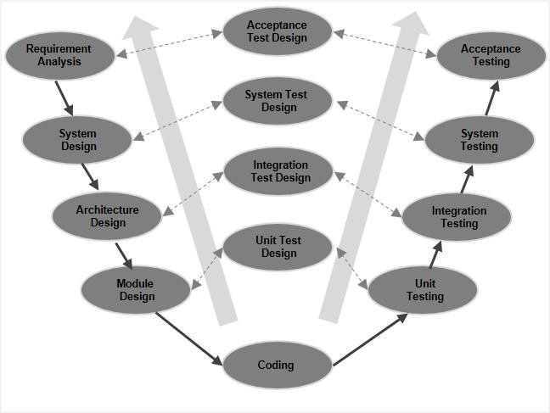
Understands requirements from customer perspective
V P
a h
l a
i s
d e
a s
t
i
design the complete system
complete hardware and communication setup for the product
  High level Design
o
n
Low level Design
The corresponding testing phase of the development phase is planned
in parallel.
So, there are Verification phases on one side of the ‘V’ and Validation
phases on the other side.
The Coding Phase joins the two sides of the V-Model

Slide 18
V-Model -The usage
Software requirements clearly defined and known. Software development technologies and tools are well- known.
The following pointers are some of the most suitable scenarios to use the V-Model application.
  Requirements are well defined, clearly documented and
fixed.
  Product definition is stable.
  Technology is not dynamic and is well understood by the project team.
  There are no ambiguous or undefined requirements.
  The project is short.

Slide 19
Advantages | Disadvantages
Simple and easy to use Each phase has specific deliverables. Higher chance of success over the waterfall model due to the development of test plans early on during the life cycle. Works well for where requirements are easily understood. Verification and validation of the product in the early stages of product development. | Very inflexible, like the waterfall model. Adjusting scope is difficult and expensive. The software is developed during the implementation phase, so no early prototypes of the software are produced. The model doesn’t provide a clear path for problems found during testing phases. Costly and required more time, in addition to a detailed plan

Slide 20
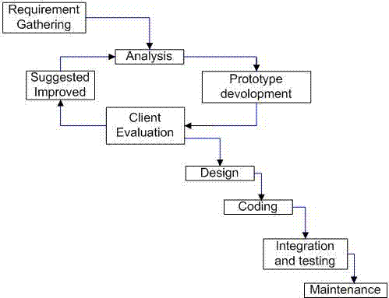
Evolutionary prototyping
Prototypes that evolve into the final system through an iterative incorporation of user feedback.

Slide 21
Iterative and Incremental Method
It is developed to overcome the weaknesses of the waterfall model.
It starts with an initial planning and ends with deployment with the cyclic interactions in between.
The basic idea behind this method is to develop a system through repeated cycles (iterative) and in smaller portions at a time (incremental),
allowing software developers to take advantage of what was learned during the development of earlier parts or versions of the system.
It can consist of mini waterfalls or mini V-Shaped model
Development begins by specifying and implementing just part of the software, which is then reviewed to identify further requirements. This process is then repeated, producing a new version of the software at the end of each iteration of the model.

Slide 22
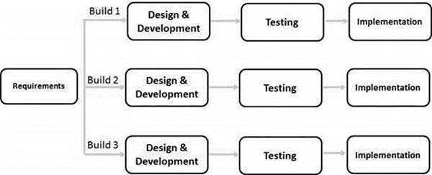
At each iteration, design modifications are made and new functional capabilities are added.
"During software development, more than one iteration of the software
development cycle may be in progress at the same time.“
the whole requirement is divided into various builds. During each iteration, the development module goes through the requirements, design, implementation and testing phases. Each subsequent release of the module adds function to the previous release. The process continues till the complete system is ready as per the requirement.

Slide 23
Iterative Model-The Usage
Requirements of the complete system are clearly defined and understood.
Major requirements must be defined; however, some functionalities or requested enhancements may evolve with time.
There is a time to the market constraint.
A new technology is being used and is being learnt by the development team while working on the project.
Resources with needed skill sets are not available and are planned to be used on contract basis for specific iterations.
There are some high-risk features and goals which may change in the future

Slide 24
Advantages
Disadvantages
Requires heavy documentation.
Follows a defined set of
processes.
Defines increments based on function and feature dependencies.
Requires more customer
Produces business value early in the development lifecycle.
Better use of scarce resources through proper increment definition.
Can accommodate some change involvement than the linear
requests between increments.
More focused on customer value than the linear approaches.
We can detect project issues and changes earlier.
approaches.
Partitioning the functions and features might be problematic.
Integration between the iterations can be an issue if it is not considered during the development and project planning.

Slide 25
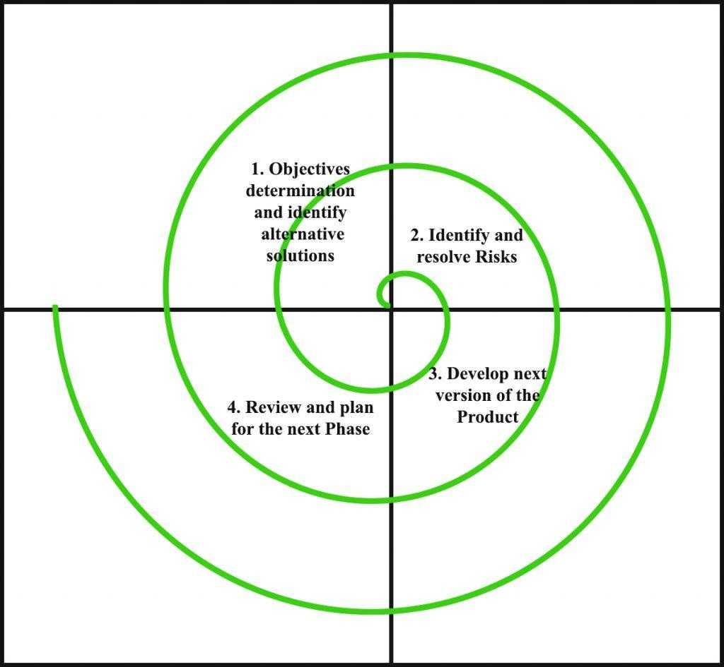
Spiral Model
It is a combination of iterative development process model and sequential linear development model i.e. the waterfall model with a very high emphasis on risk analysis
Spiral model is one of the most important Software Development Life Cycle models, which provides support for Risk Handling.
The spiral model has four phases. A software project repeatedly passes through these phases in iterations
called Spirals.

Slide 26
In its diagrammatic representation, it looks like a spiral with many loops.
The exact number of loops of the spiral is unknown and can vary from project to project.
Each loop of the spiral is called a Phase of the software development process.
The exact number of phases needed to develop the product can be varied by the project manager depending upon the project risks.
As the project manager dynamically determines the number of phases, so the project manager has an important role to develop a product using spiral model.

Slide 27
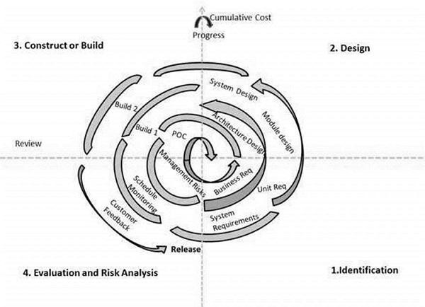
Spiral Model-Design
Identification
  gathering the business requirements.
  In the subsequent spirals as the product matures, identification of system requirements, subsystem requirements and unit requirements are all done in this phase.
  This phase also includes understanding the system requirements by continuous communication between the customer and the system analyst
Design
  the conceptual design in the baseline spiral and involves architectural design, logical design of modules, physical product design and the final design in the subsequent spirals
Construct or Build
  the actual software product at every spiral
  In the baseline spiral, when the product is just thought of and the design is being developed a POC (Proof of Concept) is developed in this phase to get customer feedback
  the subsequent spirals with higher clarity on requirements and design details a working model of the software called build is produced with a version number. These builds are sent to the customer for feedback.
Evaluation and Risk Analysis
  Risk Analysis includes identifying, estimating and monitoring the technical feasibility and management risks, such as schedule slippage and cost overrun. After testing the build, at the end of first iteration, the customer evaluates the software and provides feedback.

Slide 28
Spiral Model-The Usage
The following pointers explain the typical uses of a Spiral Model
  When there is a budget constraint and risk evaluation is important.
  For medium to high-risk projects.
  Long-term project commitment because of potential changes to
economic priorities as the requirements change with time.
  Customer is not sure of their requirements which is usually the case.
  Requirements are complex and need evaluation to get clarity.
  New product line which should be released in phases to get
enough customer feedback.
  Significant changes are expected in the product during the development cycle.

Slide 29
Advantages | Disadvantages
Estimates (i.e. budget, schedule, etc.) become more realistic as work progressed because important issues are discovered earlier. Early involvement of developers. Manages risks and develops the system into phases. | High cost and time to reach the final product. Needs special skills to evaluate the risks and assumptions. Highly customized limiting re-usability

Slide 30
Agile Model
It is based on iterative and incremental development,
where requirements and solutions evolve through
collaboration between cross-functional teams.
Agile Methods break the product into small incremental builds.
These builds are provided in iterations. Each iteration typically lasts from about one to three weeks.
Every iteration involves cross functional teams working
simultaneously on various areas like −
  Planning
  Requirements Analysis
  Design
  Coding
  Unit Testing and
  Acceptance Testing.

Slide 31
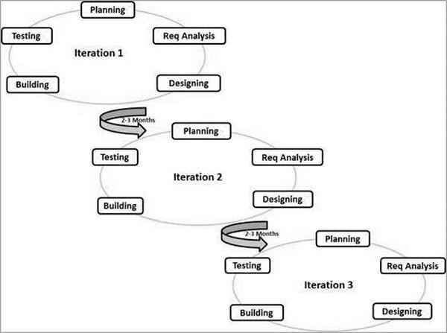
Graphical illustration of Agile Model
Iterative approach is taken and working software build is delivered after each iteration. Each build is incremental in terms of features; the final build holds all the features required by the customer

Slide 32
Agile-Principles
Individuals and interactions − In Agile development, self- organization and motivation are important, as are interactions like co-location and pair programming.
Working software − Demo working software is considered the best means of communication with the customers to understand their requirements, instead of just depending on documentation.
Customer collaboration − As the requirements cannot be gathered completely in the beginning of the project due to various factors, continuous customer interaction is very important to get proper product requirements.
Responding to change − Agile Development is focused on
quick responses to change and continuous development.

Slide 33
Advantages | Disadvantages
Decrease the time required to avail some system features. Face to face communication and continuous inputs from customer representative leaves no space for guesswork. The end result is the high- quality software in the least possible time duration and satisfied customer. | Scalability. The ability and collaboration of the customer to express user needs. Documentation is done at later stages. Reduce the usability of components. Needs special skills for the team.

Slide 34
References
https://melsatar.blog/2012/03/15/softwaredevel opment-life-cycle-models-andmethodologies/
https://www.geeksforgeeks.org/softwareenginee ring-spiral-model/
https://medium.com/@lizparody/waterfall- vsagile-methodology-in-software- development1e19ef168cf6
https://www.tutorialspoint.com/sdlc/sdlc_waterf all_model.htm

Slide 35
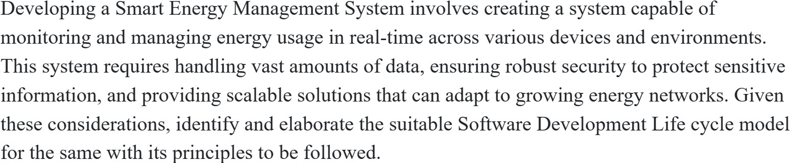
Identify the model
Consider a system to develop an IoT system that monitors room temperature, displays real-time data on a mobile app, and sends alerts if temperatures go beyond a set range. The process enables flexibility and rapid updates, which is ideal for IoT projects where user needs evolve and technology integration changes frequently.

Slide 36
Project demonstration
REV 2 : demonstration of AI Model (April 1st week).
REV 3 : Deployment and document submission (April 3rd week)

